Slide 1
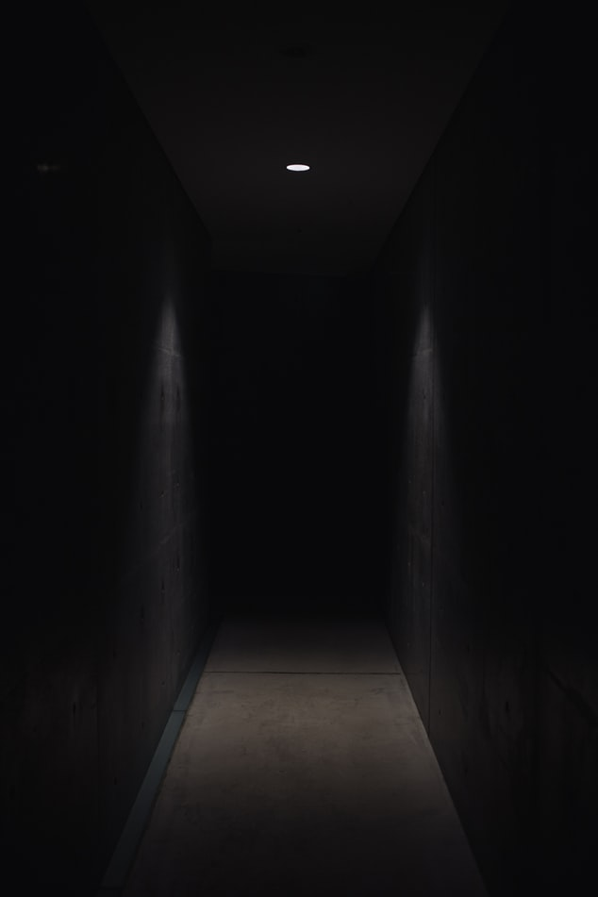
‘The Dorm’
FNMI DESIGN SPACE

Slide 2
Selkirk Secondary School
Kimberley, BC

Slide 3
Does design space learning enhance student engagement in the inquiry process?

Slide 4
The unit focused on discovery within Residential Schools as there were no “predefined outcome[s] but a general topic which students [posed[ and [answered] questions of their own making”
Gini Newman, 2018, p. 40

Slide 5
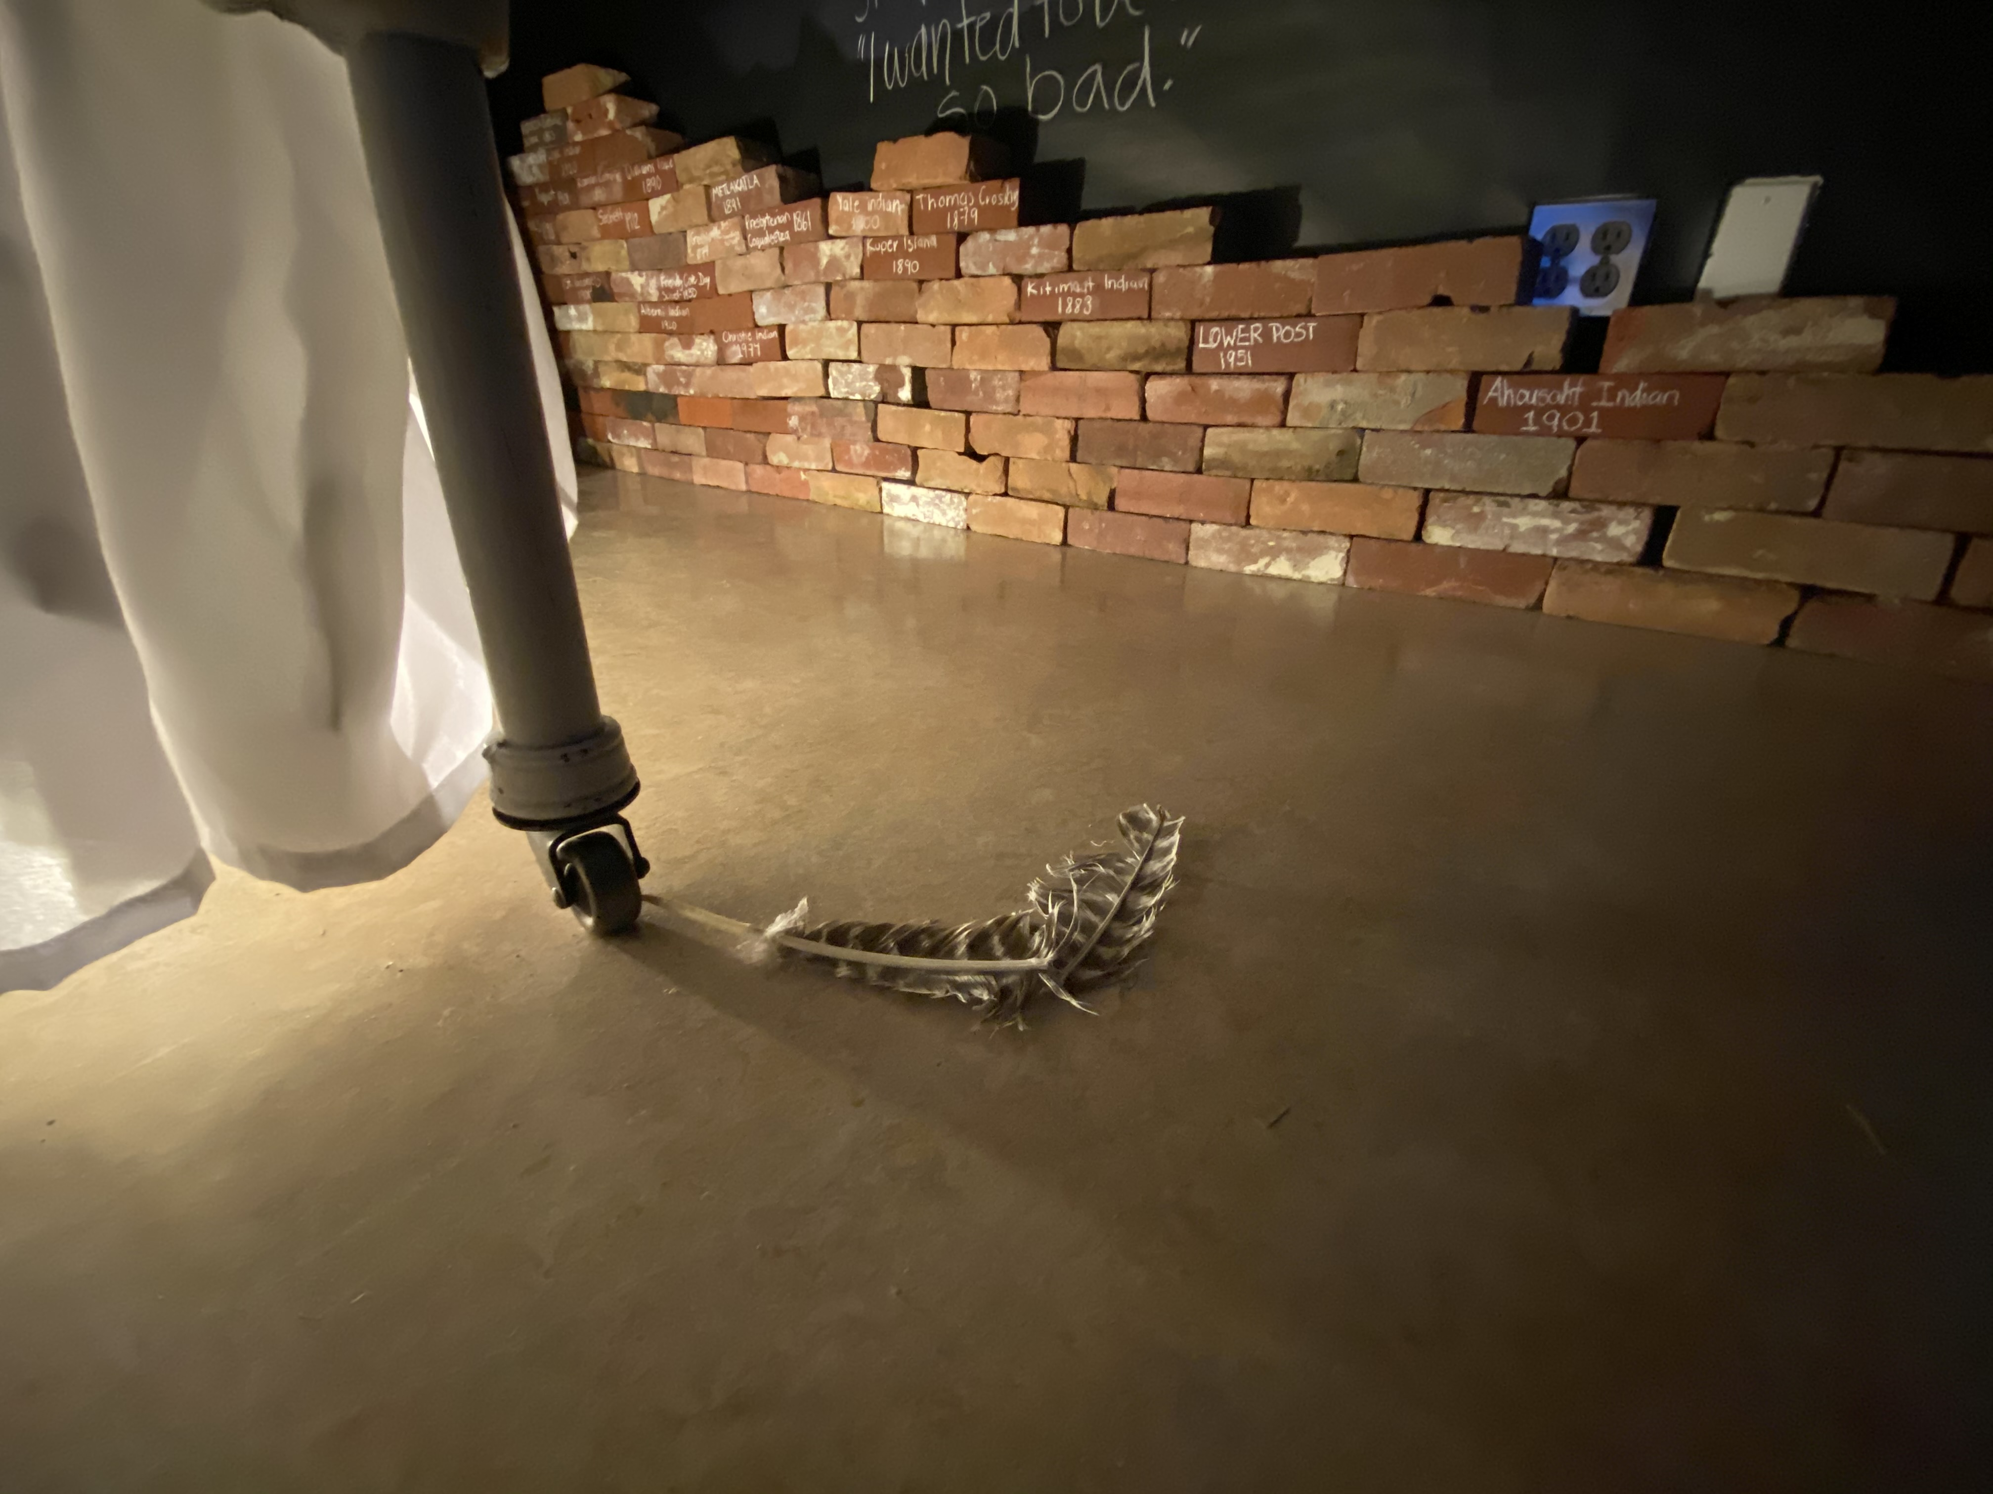
The goal of this project was for students to design a room that guests could walk into and further their understanding of Residential School legacies.
I encouraged students to consider how they could evoke an emotional response from their audience when they entered the room and experienced the installation.

Slide 6
Ideation: initial brainstorm of ideas
Iteration: what can you improve
Prototype: creating an example for others to improve on
Design Thinking
Design space learning is empowering students to purposefully create a space using a design thinking structure.
THE FRAMEWORK

Slide 7
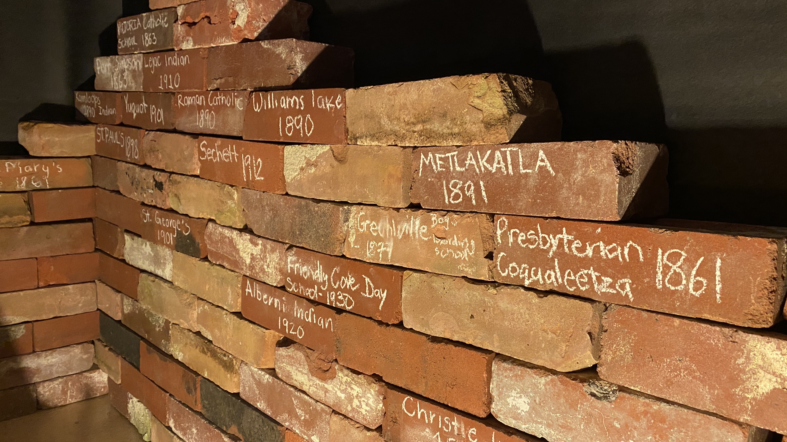
Challenges
Having enough daily tasks
Assessment of students
‘Guess work’ for timing

Slide 8
'The Dorm': FNMI Design Space Learning in High School

